Slide 1
Seismic Network and Recent Seismicity in UAE and adjacent areas
by
Khalifa Alebri, H.Alhajeri
National Center of Meteorology & Seismology (NCMS)
Workshop on Training in Network Management systems and analytical Tools for Seismology, 23-27 Oct 2017, Baku

Slide 2
Contents
About NCMS
Seismic Network
Instruments & Communications
Seismicity recorded in UAE and Adjacent areas
Structural Health Monitoring
Emergency process

Slide 3
National Center of Meteorology & Seismology
Chairmen Board
Executive Director
Logistic & Costumers Department
Technical Department
Research, Development & Training Department
Seismology Department
Meteorology Department
Internal Audit Unit
Executive Director Secretaries
Strategic Planning & Performance Unit
International Affairs Unit
Legal Affairs Unit
Media Services & Marketing
Finance & Purchase
Human resources
Costumer & Quality
Information Technology
Network & Communication
Maintenance & Calibration
Scientific Research & Studies
Training
Development
Earthquake Monitoring
Earthquake Engineering & Geology
General Forecast
Aviation Forecast
Marine
Forecast
Climate
Cloud seeding
Applications

Slide 4
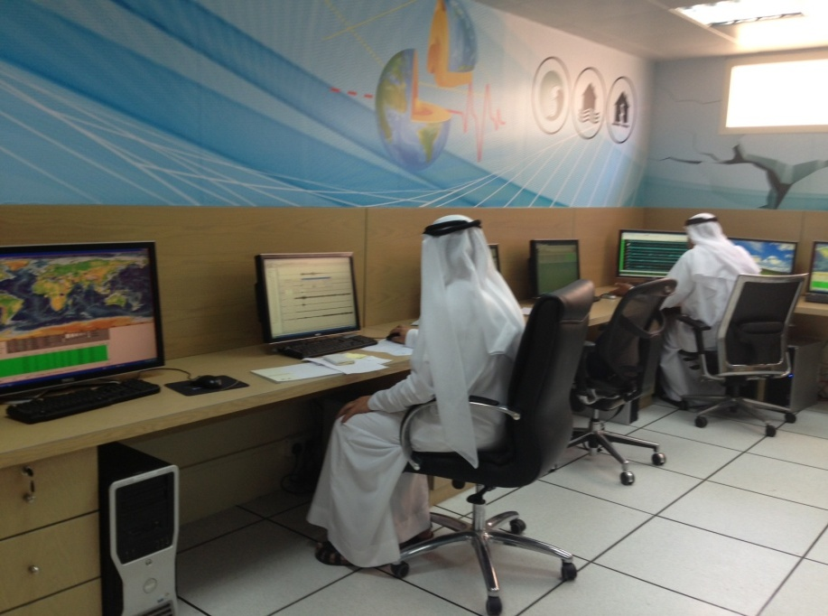
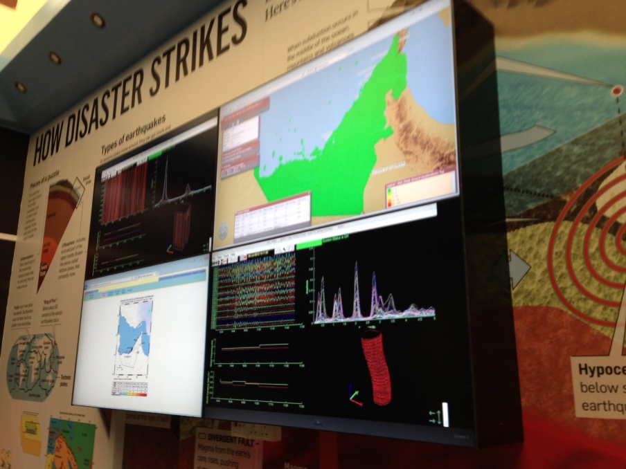
Earthquake Monitoring and Display Centre
Earthquake Monitoring room
Display Screen(SHM, MMI, Risk Analysis

Slide 5
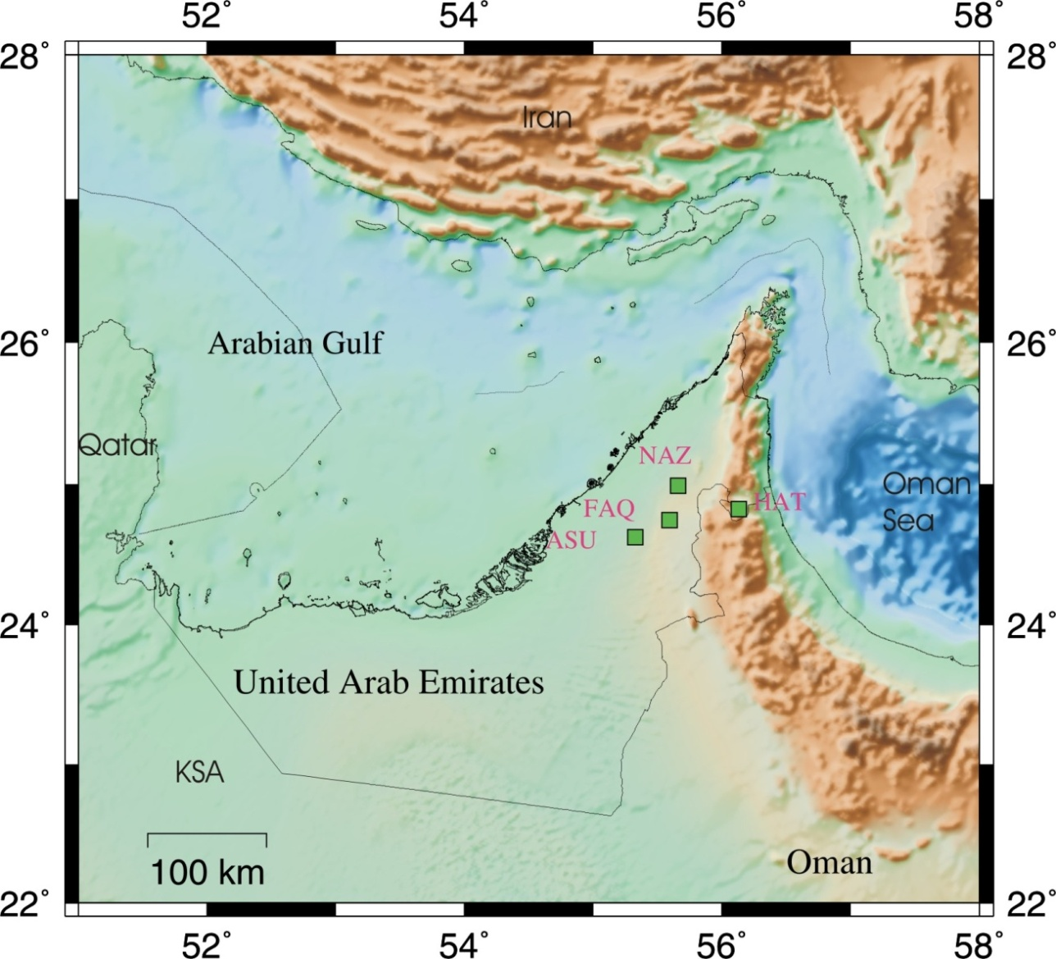
UAE Seismic Network Stage 1 - Dubai

Slide 6

UAE Seismic Network Stage 2 - Progress

Slide 7
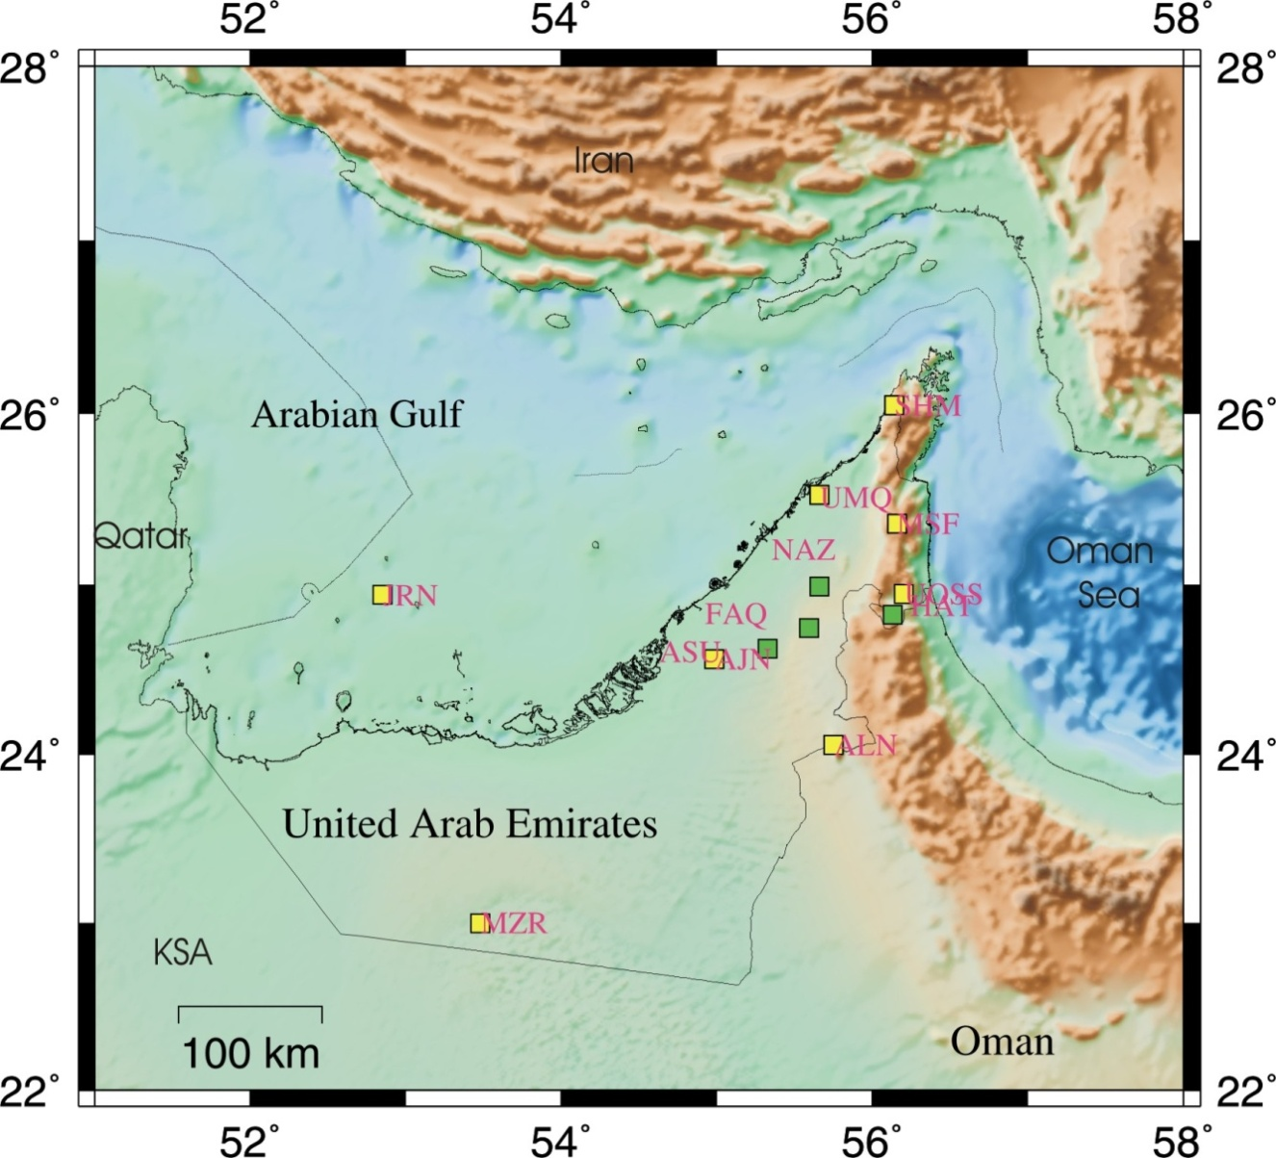
UAE Seismic Network Stage 3 - Progress

Slide 8
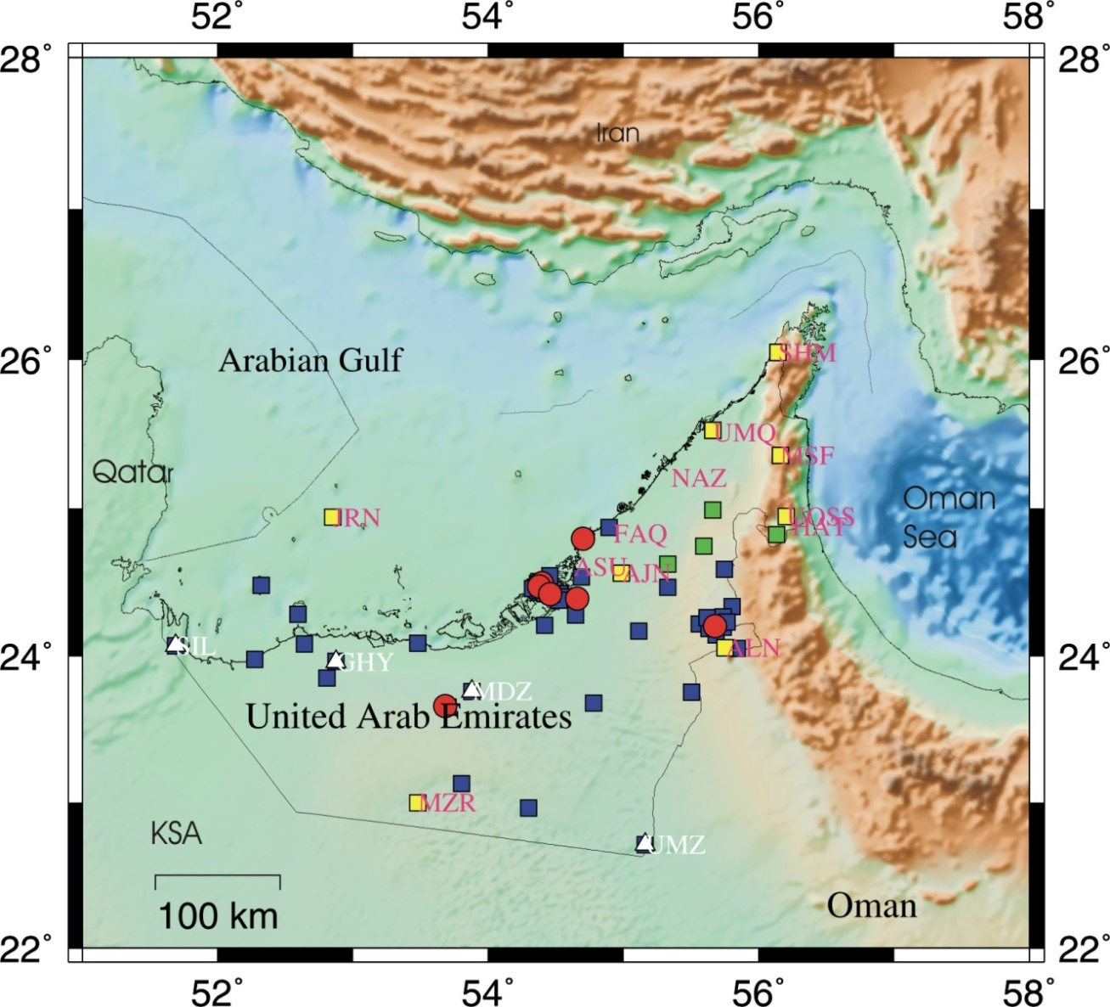
UAE Seismic Network Stage 4 - Progress
Notes:
Lots of Strong motion detectors are shown on the figure above

Slide 9

UAE Seismic Network Stage 5 - Current
Notes:
Lots of Strong motion detectors are shown on the figure above

Slide 10
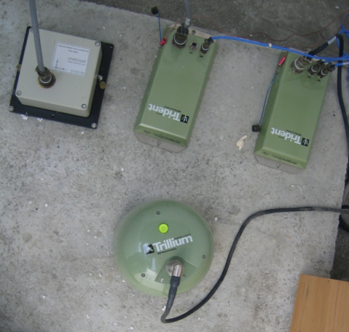
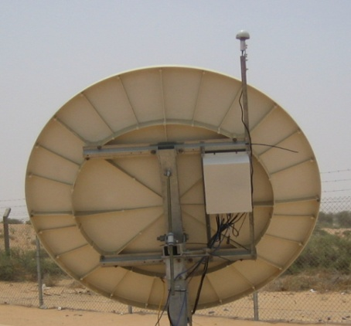
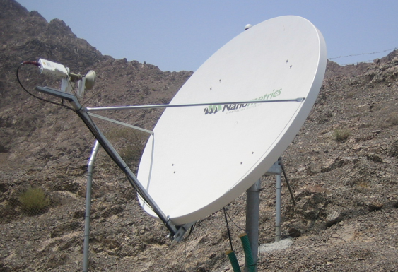
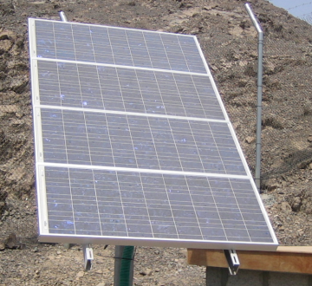
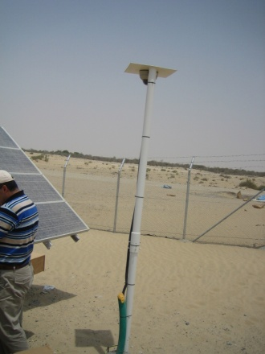
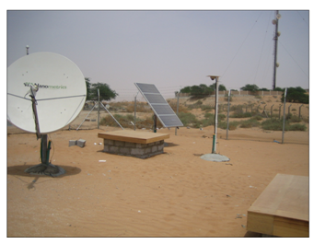
BB Seismic Station

Slide 11
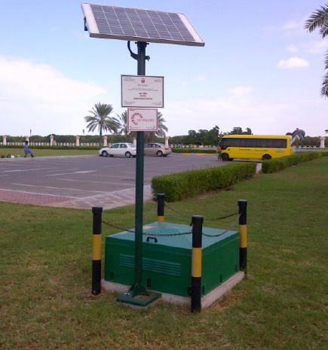
Strong Motion Station

Slide 12
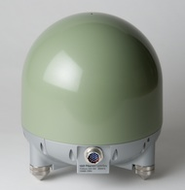
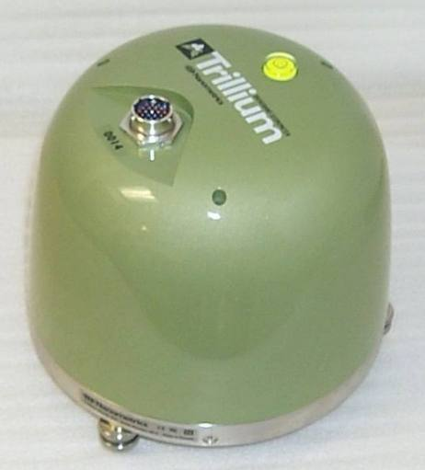
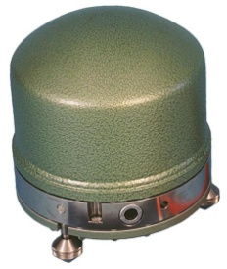
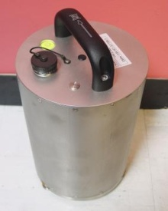
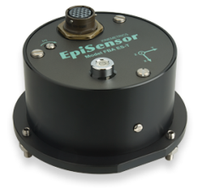
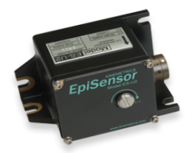
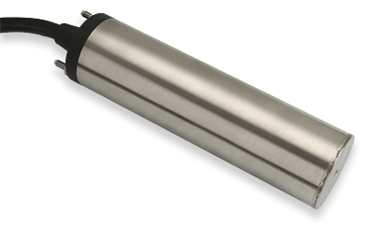

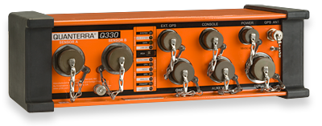
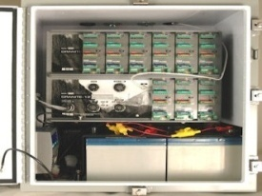

Instruments
Weak Motion Sensors
Strong Motions Sensors
Digitizers
Trillium240
Trillium40
STS-2
Guralp,CMG-3T
ES-U2
ES-T
SBEPI
Taurus
Trident
Q330
Dolomite
Basalt

Slide 13

Communications
GSN
Stations
Hydra Server
REAL-TIME
PROCESSING
Dubai
Network
Internet
SEED Link
Server
Athena
Server
ADM
Network
Apollo
Server
REAL-TIME
Publishing & Archiving Earthquake
parameter
Internet
Oman Network
REAL-TIME
Acquisition
Apollo
Project
Archiving Waveform
(MINI SEED)
NCMS
Network
Notes:
Quake view of the network progress

Slide 14
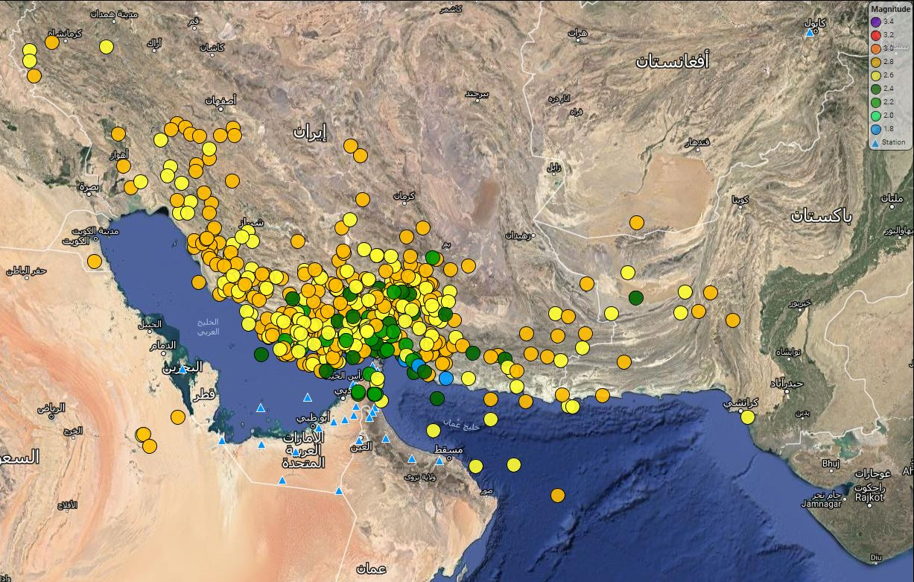
Seismicity
1128 Earthquakes with Magnitude < 3
Notes:
1128 earthquake

Slide 15
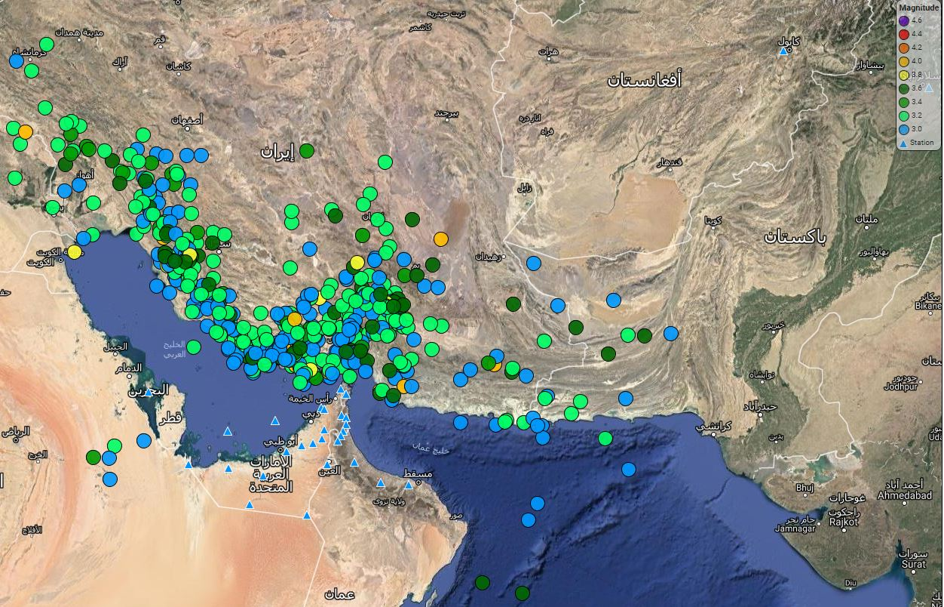
Seismicity
1736 Earthquakes with Magnitude between (3 and 4)
Notes:
1736 earthquake

Slide 16
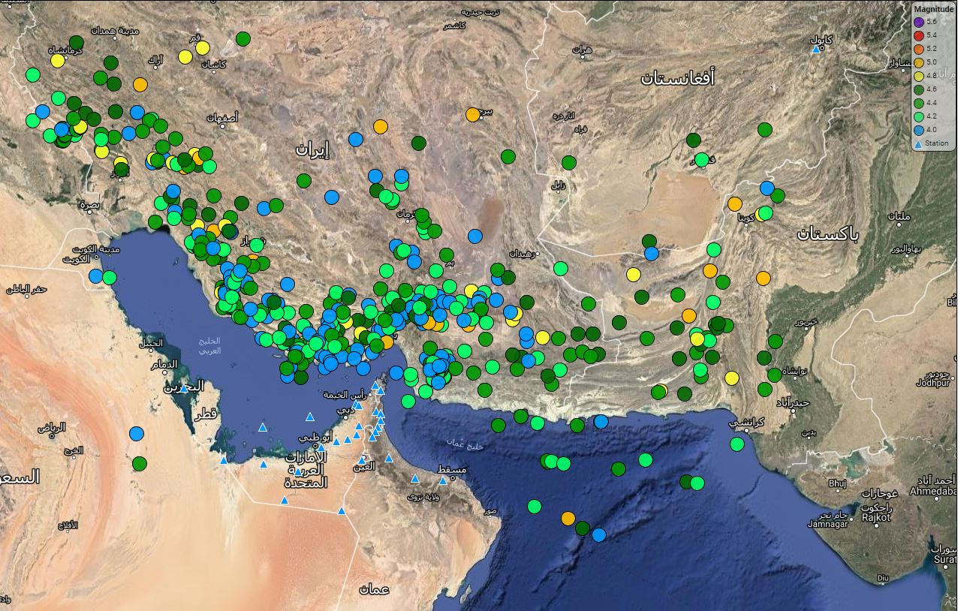
Seismicity
550 Earthquakes with Magnitude between (4 and 5)
Notes:
550 earthquacke

Slide 17
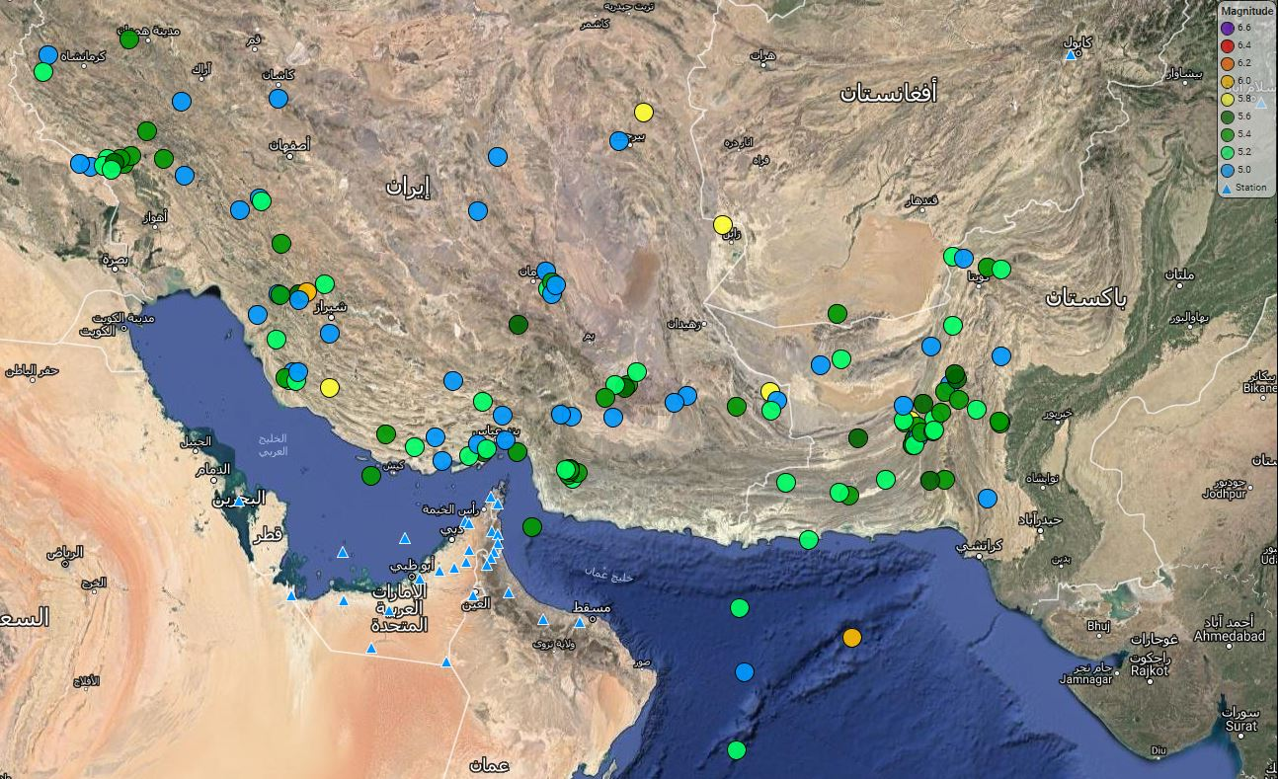
Seismicity
132 Earthquakes with Magnitude between 5 and 6
Notes:
132 earthquake
We figured out that the Model velocity does not effect the location it is only effect the depth of the earthquake

Slide 18
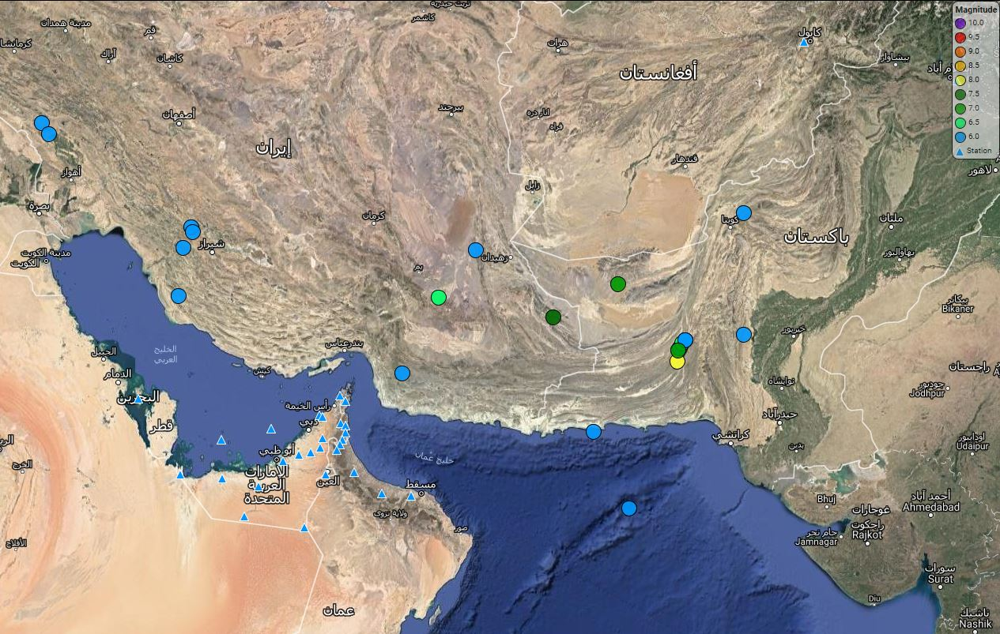
Seismicity
21 Earthquakes with Magnitude > 6
Notes:
21 earthquake

Slide 19
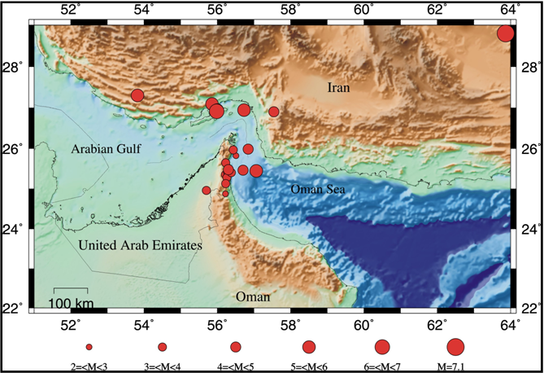
Felt Earthquakes Map

Slide 20
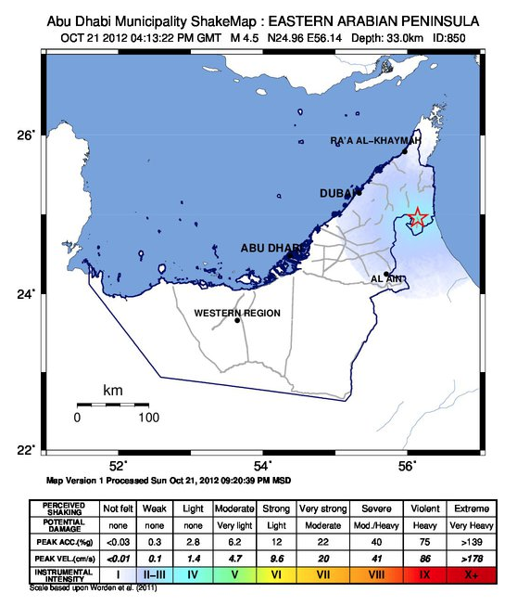
Shake Map Web page

Slide 21
Why Structural Health Monitoring established
One of the most fundamental objectives of SHM is to study:
Dynamic response of Structures subjected to strong earthquakes or wind loads.
The data obtained is used to confirm the structural response, e.g., vibration mode, natural frequencies, and damping,
by comparing this response with that assumed in the structural design .
It can be further applied to improve design method or develop new Technology (Seismic Building Code) .

Slide 22
Main functions of structural health monitoring
Monitor and assess load conditions
Examine current design philosophy
Live monitoring
Assess structure safety following a major event
Reliable data on actual condition of structure
Detect early signs of failure
Facilitate inspection and maintenance works
Help authority to make quick and right decision in emergency cases

Slide 23




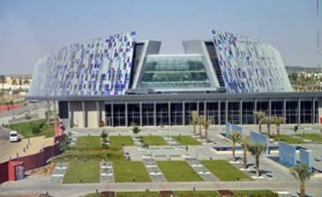


Unique design and Ultra tall buildings

Slide 24
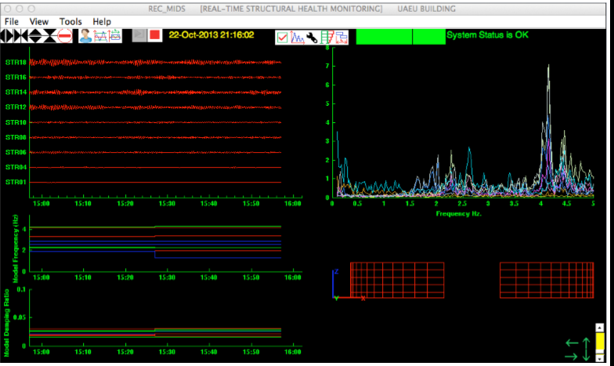
SHM Outputs
Real time data
Spectral Frequency
Damping Ratio
Mode Shape Animation
Notes:
Real time data, Spectral Frequency
Damping Ratio, Mode shape Animation

Slide 25
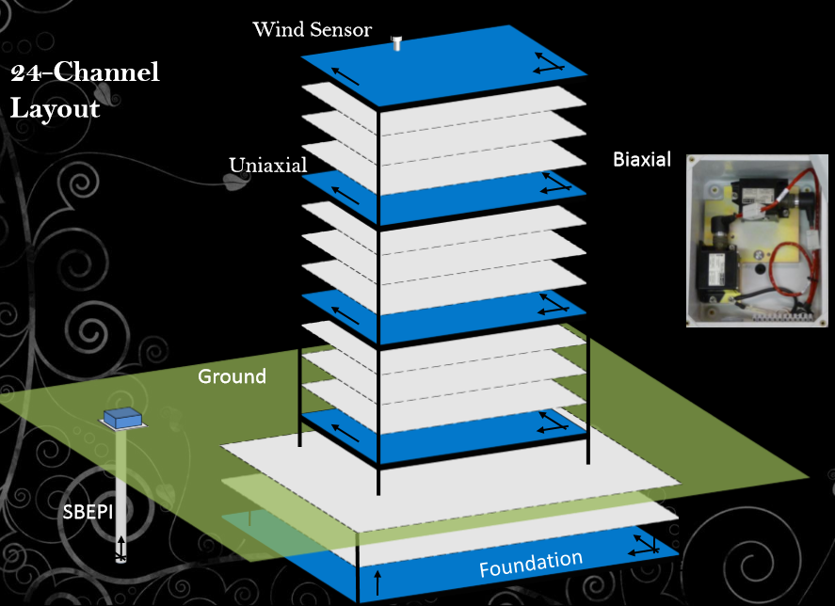
SHM system

Slide 26

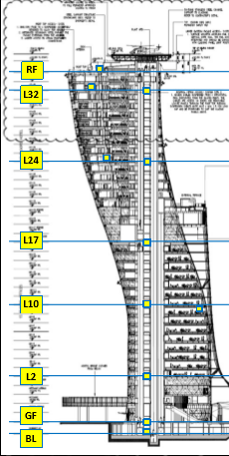
ADNEC Capital Gate (35 floors)

Slide 27
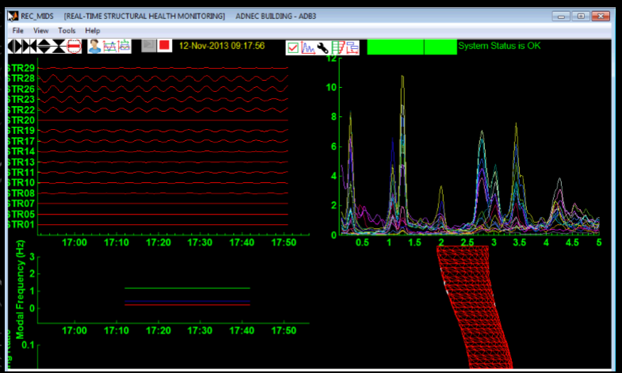
SHM Outputs
Real time data
Spectral Frequency
Damping Ratio
Mode Shape Animation

Slide 28
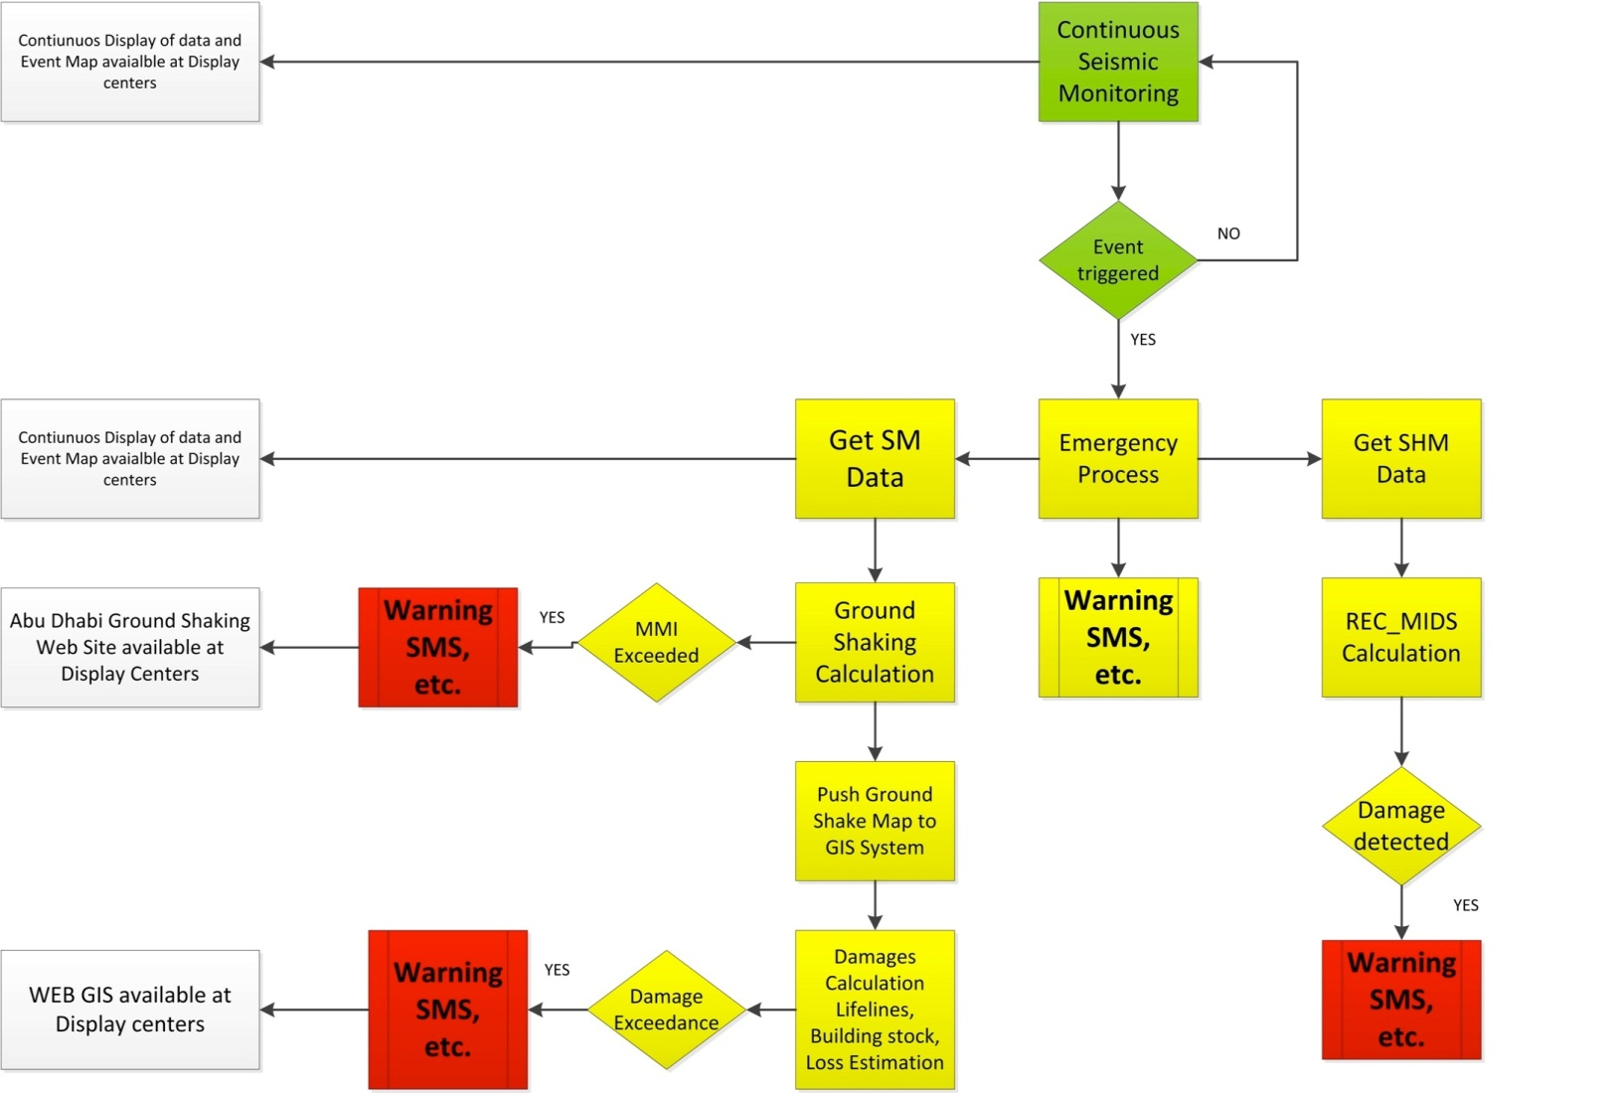
System Flow Chart of Emergency process

Slide 29
SHM ALARM SYSTEM
Alarm threshold levels in the installed structural Health monitoring (SHM) systems are set based on story drift ratios . The alarm threshold system consists of three levels as follows :
Alarm Level 1: – Story drift ratio= 0.005 – Safety level: Immediate occupancy
Alarm Level 2: – Story drift ratio= 0.010 – Safety level: Life safety
Alarm Level 3: - Story drift ratio= 0.020 - Safety level: Collapse prevention

Slide 30
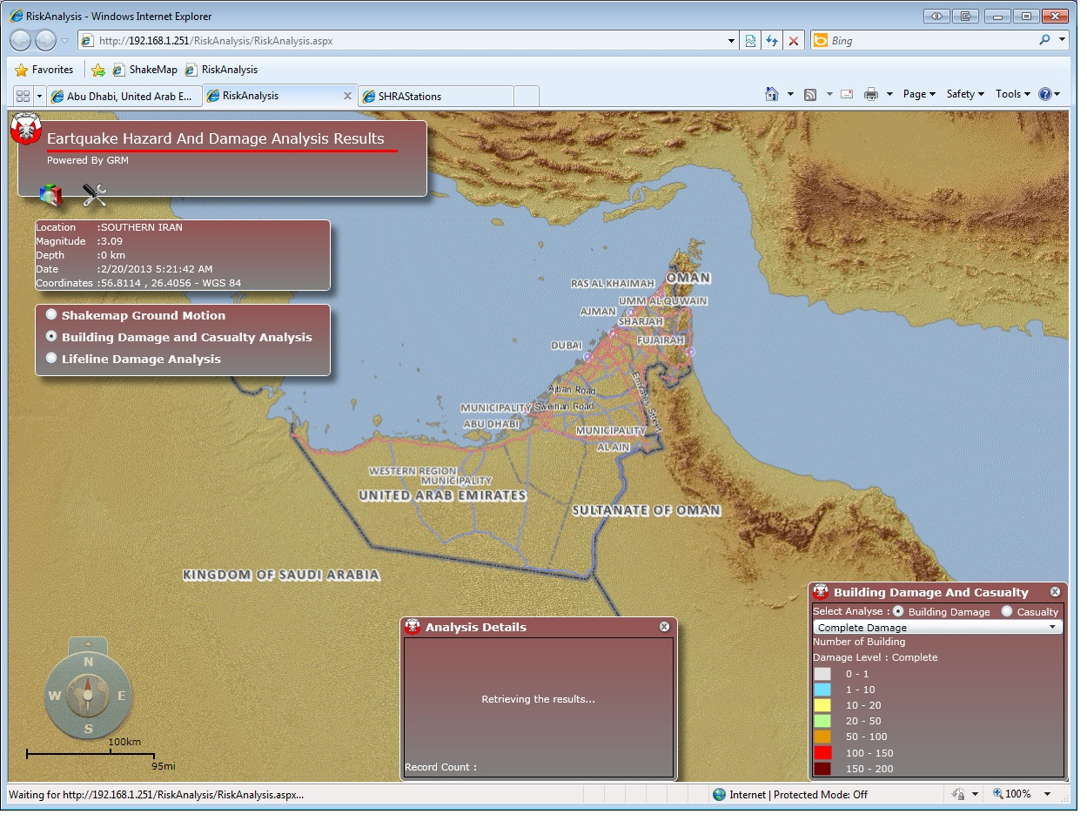
Loss Estimation Web Page

Slide 31




Thank you
Notes:
Everywhere I look I see architecture that takes my breath away. Scale, construction methods, architectural features.
Sheik Zayed Grand Mosque
Aldar HQ
Capital Gate
Ferrari World
Yas Hotel

